Slide 1
Meet Dr. Roher

Slide 2
I look like…

Slide 4
I like to think about…

Slide 6
My best character trait is…

Slide 7
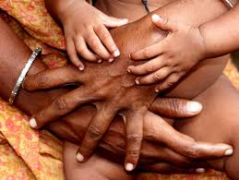
Notes:
I care about people

Slide 8
I would like to develop this trait…

Slide 9
Notes:
relaxation

Slide 10
I am most scared of…

Slide 11
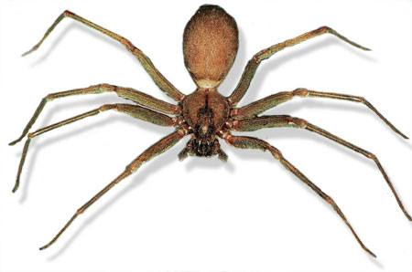
Notes:
Spiders

Slide 12
I am most interested in…

Slide 13
Notes:
Technology and Education

Slide 14
I get along best with….

Slide 16
I learn best by…

Slide 17
Notes:
I like to hear and see a demonstration. Then I like to do and tell, to show I know what I was suppose to learn.

Slide 18
My best developed talent is…

Slide 19
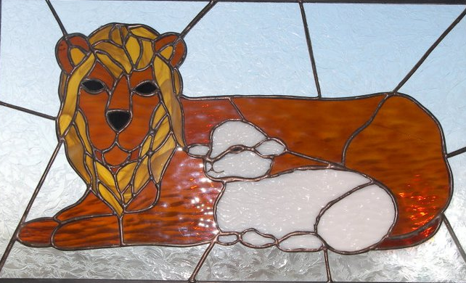
Notes:
Stained Glass

Slide 20
I would like to develop this talent…

Slide 21
Notes:
Become confident in writing

Slide 22
My secret dream is…

Slide 23
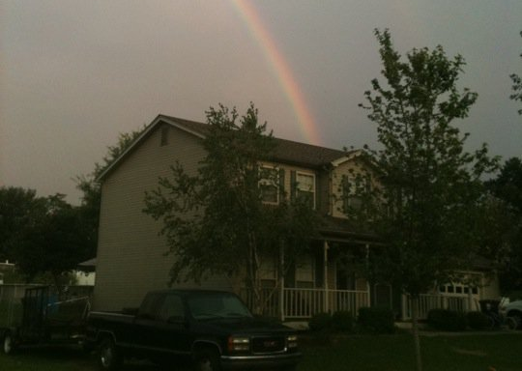
Notes:
Work from home.

Slide 24
Ten years from now, I hope…

Slide 25
Notes:
Teaching online full time.

Slide 26
To reach my goal, I have to…

Slide 27
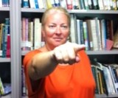
Notes:
School Districts and technology availablity to catch up

Slide 28
Works Cited
Caring Image: http://ugandaorphanage.org/
Relaxation Image: www.relaxationforme.com
Spider Image: www.desertusa.com
Technology Image: http://www.mediamakechange.org People Image: totalbodybayou.com
Writing Image: maineschoolwritingcenters.blogspot.com
Teach Online: teachthe4ps.com

